Slide 1
Overview of Query Evaluation

Slide 2
Introduction
Present an overview of how queries are evaluated in a relational DBMS.
Metadata and system catalog.
Operator evaluation and evaluation algorithm.
Query optimization is to find a good evaluation plan.
Example schema:
  Sailors (sid: integer, sname: string, rating: integer, age: real) (40 bytes/tuple, 100tuples/page, 1000 pages)
  Reserves (sid: integer, bid: integer, day: dates, rname: string) (50 bytes/tuple, 80tuples/page, 500 pages)
Notes:
4

Slide 3
System Catalogs
For each relation:
  name, file location, file structure (e.g., Heap file)
  attribute name and type, for each attribute
  index name, for each index
  integrity constraints
For each index:
  structure (e.g., B+ tree) and search key fields
For each view:
  view name and definition
Plus statistics, authorization, buffer pool size, etc.
  Cardinality, Size, Index Cardinality, Index Size, Index Height, Index Range

Slide 4
Attr_Cat(attr_name, rel_name, type, position)
attr_name
rel_name
type
position
attr_name
Attribute_Cat
string
1
rel_name
Attribute_Cat
string
2
type
Attribute_Cat
string
3
position
Attribute_Cat
integer
4
sid
Sailors
integer
1
sname
Sailors
string
2
rating
Sailors
integer
3
age
Sailors
real
4
sid
Reserves
integer
1
bid
Reserves
integer
2
day
Reserves
dates
3
name
Reserves
string
4

Slide 5
Operator Evaluation
Three common techniques:
  Indexing: Use an index to examine just the tuples that satisfy the condition (selection or join condition)
  Iteration: Examine all tuples in an input table, one after the other
  Partitioning: Sorting and hashing are two commonly used partitioning techniques

Slide 6
Access Paths
An access path is a way of retrieving tuples from a table and consists of either (1) a file scan or (2) an index plus a matching selection condition. Every relational operator accepts one or more tables as input, and the access methods used to retrieve tuples contribute significantly to the cost of the operator.
A simple selection that is a conjunction of conditions of the form attr op value. Such selections are said to be in conjunctive normal form (CNF), and each condition is called a conjunct.
  A hash index matches a CNF selection
  A tree index matches a CNF selection
  The conjuncts that the index matches are called the primary conjuncts in the section

Slide 7
Access Paths (cond)
Hash index H on the search key <rname, bid, sid>. Match the condition: rname='Joe' ∧bid=5 ∧ sid=3. Does not match rname='Joe' ∧bid=5 or some condition on date.
B+-tree index would match the conditions rname='Joe' ∧bid=5 ∧ sid=3 and rname='Joe' ∧bid=5 and would not match bid=5 ∧ sid=3.
Have an index (hash or tree) on the search key <bid, sid> and the selection condition: rname='Joe' ∧bid=5 ∧ sid=3. bid=5 ∧ sid=3 is the primary conjuncts.

Slide 8
Selectivity of Access Paths
The selectivity of an access path is the number of pages retrieved if we use this access path to retrieve all desired tuples. The most selective access path is the one that retrieves the fewest pages.
The fraction of tuples in the table that satisfy a given conjunct is called the reduction factor.

Slide 9
Algorithms for Relational Operations
Selection: a simple retrieval of tuples form a table.
Project: drop certain fields of the input. To ensure that no duplicates appear in the result.
Join: expensive operations and very common. Systems typically support seveal algorithms to carry out joins.
  index nested loops join
  sort-merge join
  Other operations: group-by, aggregation and set operations such as union and intersection

Slide 10
Query Optimization
Queries are parsed and then presented to a query optimizer, which is responsible for identifying an efficient execution plan.
The optimizer generates alternative plans and choose the plan with the least estimated cost.
  Enumerating alternative plans for evaluating the expression.
  Estimating the cost of each enumerated plan

Slide 11
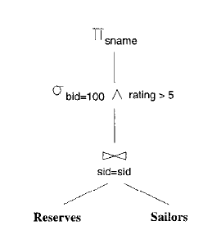
Query Evaluation Plans
A query evaluation plan consists of an extended relational algebra tree, with additional annotations at each node indicating the access methods to use for each table and the implementation method to use for each relational operator.
SQL query:
SELECT S.sname
FROM Reserves R, Sailors S
WHERE R.sid = S.sid AND R.bid = 100 AND S.rating > 5
  π_{sname} (σ_{bid=100∧rating>5}(Reserves _{sid=sid} Sailors))
  This expression is shown in the form of a tree in Figure 12.3.

Slide 12
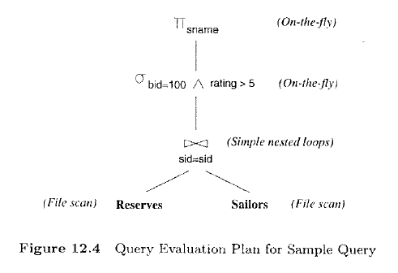
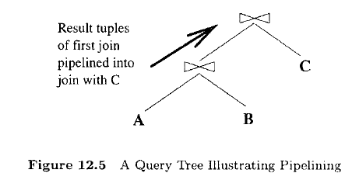
Multi-operator Queries: Pipelined Evaluation
When a query is composed of several operators, the result of one operator is sometimes pipelined to another operator without creating a temporary table to hold the intermediate result.
If the output of an operator is saved in a temporary table for processing by the next operator, we say that the tuples are materialized.

Slide 13
The Iterator Interface
To simplify the code responsible for coordinating the execution of a plan, the relational operators that form the nodes of a plan tree typically support a uniform iterator interface, hiding the internal implementation details of each operator.
The iterator interface for an operator includes the functions open, get_next, and close.

Slide 14
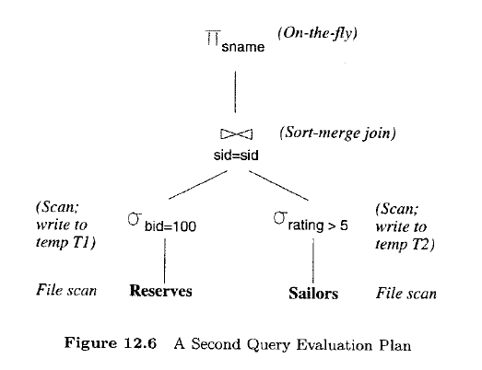
Alternative Plans: A Motivating Example
Pushing Selections. A join is a relatively expensive operation, and a good heuristic is to reduce the sizes of the tables to be jointed as much as possible. One approach is to apply selections early; if a selection operator appears after a join operator, it is worth examining whether the selection can 'pushed' ahead of the join.

Slide 15
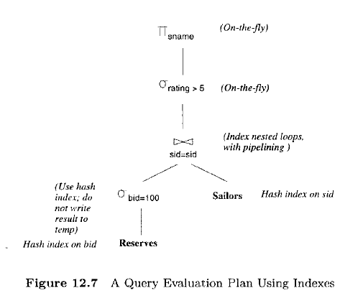
Alternative Plans: A Motivating Example (cond)
Using Indexes. If indexes are available on the Reserves and Sailors tables, even better query evaluation plans may be available.

Slide 16
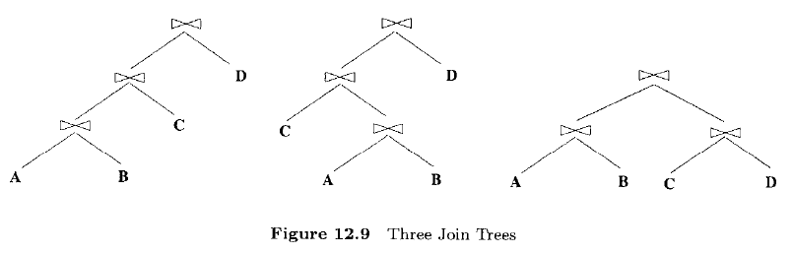
What A Typical Optimizer Does
Alternative plans considered. Two relational algebra expressions over the same set of input tables are said to be equivalent if they produce the same result on all instances of the input tables.
Left-Deep Plans.

Slide 17
What A Typical Optimizer Does (cond)
Estimating the Cost of a Plan. The cost of a plan is the sum of costs for the operators it contains. The cost of individual relational operators in the plan is estimated using information, obtained from the system catalog, about properties (e.g., size, sort order) of their input tables.
The I/O cost of a plan can be broken down into three parts: (1) reading the input tables, (2) writing intermediate tables, and (3) sorting the final result.
The result size for a join can be estimated by multiplying the maximum result size, which is the product of the input table sizes, by the reduction factor of the join condition.

